Slide 1
RECOMMENDER SYSTEM
Online Retail

Slide 2
Agenda
What is a Recommender System
Why do we need a Recommender System
What’s with the Data
  Exploratory Data Analysis
  Data Cleanup and Preprocessing
Inside Story
  Insights into different approaches
Demo
Future Work

Slide 3
What and Why
Internet and Data overload
Diverse set of Customers
Helps understand the ecosystem better and drive revenue
Personalization
Identify new opportunities for cross selling and upselling the products
Assortment arrangement
Drive marketing campaigns

Slide 4
Data
Exploratory Data Analysis (EDA)
  UCI dataset for online retail
  Half million records across 38 countries [model is build for ‘Germany’ region]
  Sales and Return transactional data
  United Kingdom contributes to 90% data
  StockCode, CustomerID and Quantity as the key features
Data Cleanup and preprocessing
  Segregate the data as sales and return transactions
  Impute missing data (StockCode and Description)
  Drop columns not adding value
    Invoice Date, Country, Unitprice, InvoiceNo
  Convert the columns (StockCode and CustomerID) to appropriate types
  Filter outliars in quantity feature with the mean
  Create mapper classes for StockCode, Description and Quantity

Slide 5
Approaches
Popularity based
Content based
Collaborative filtering
  Item based
  User based
Hybrid
Market Basket Analysis

Slide 6
Popularity based
Works with the Trending products
Solves cold start problem
Not personalized
When and How we have used ?
  When the stockCode or the CustomerID is not found in the system, recommend the top trending products
  Pick the top most selling items across the product line based on the quantity

Slide 7
Content based
Uses information about products or the users to model recommendations
Contents can be described using labels and labels are assigned weights
Nearest neighbours based on the weights are grouped as recommendations
When and How we have used ?
  Product description is used and implemented using term frequency vectorizer
  Used in association with the item collaborative filtering

Slide 8
Collaborative filtering
Solely based on the past interactions recorded between users and items
User-Item interaction matrix
Quantity of the item purchased
Item based and User based
What we have used?
KNN model – cosine similarity

Slide 9
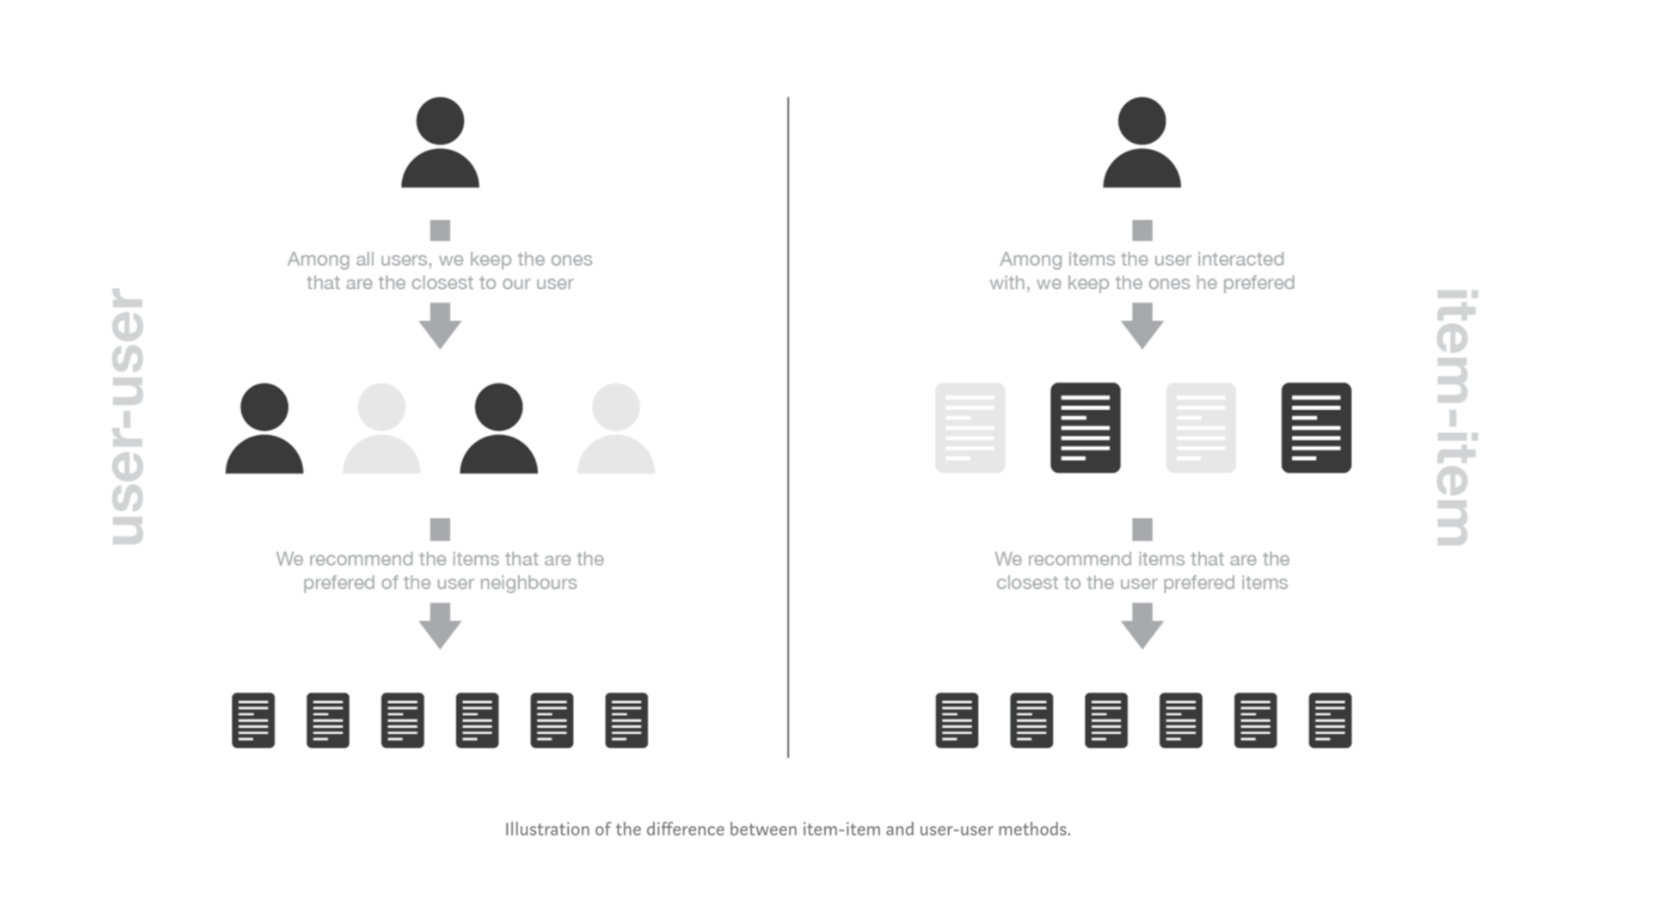

Slide 10
Item based
  we find items similar to the ones the user already “positively” interacted with products (purchased x units of the product)
  two items are considered to be similar if most of the users have interacted with both of them in a similar way (purchased similar portion of quantity).
  This method is said to be “item- centred” as it represent items based on interactions users had with them and evaluate distances between those items to make recommendations.
User based
  we find users who are similar based on “positively” interaction with products (purchased x units of the product)
  model will recommend items from top two neighbours who are 75% similar (distance > 0.75)

Slide 11
Hybrid
Collaborative
Filtering - Item
Input
Recommendations
Content based
Popularity based

Slide 12
Market Basket Analysis
Identify cross selling products
Evaluation metrics - Support, Lift and Confidence
Associated items
  SPACEBOY CHILDRENS CUP and SPACEBOY CHILDRENS BOWL
  CHILDRENS CUTLERY SPACEBOY and CHILDRENS CUTLERY DOLLY GIRL
What we have used?
Apriori

Slide 13
Demo
Flask APIs
  popularItems
  contentBased
  collabBasedItem
  collabBasedUser
  hybridBased
Visualize the recommendations
  Javascript
  REST Client

Slide 14
Future Work
Enhance with product category level recommendations
Improvise content based filtering using different NLP techniques
Derive new feature (rating scale) from the quantity feature
Fine tune the model based on the frequency [start of a week/month] of purchase
Extend and evaluate other techniques of clustering and classification (may be random forest)
Model return transactions to draw insights

Slide 15
Questions ???

Slide 16
Thank You!

